Slide 1

Genomic Data Visualization: Review
Prof. Jean Fan

Slide 2
Lesson goals
Review based on reflection cards and for quiz
Quiz (note: will be dropped from your final grade if it does not help)
Note: last day to add classes is this Friday

Slide 3
Notes on HW1
You are welcome to make as many pulls (submit) as you want before the deadline
Please don’t take my example as a gold-standard (it is an intentionally a poor example)
Think critically and explain how you are applying data visualization principles e.g. why are you encoding information the way you did?
If you used references, please include them as links at the end of the markdown file

Slide 4
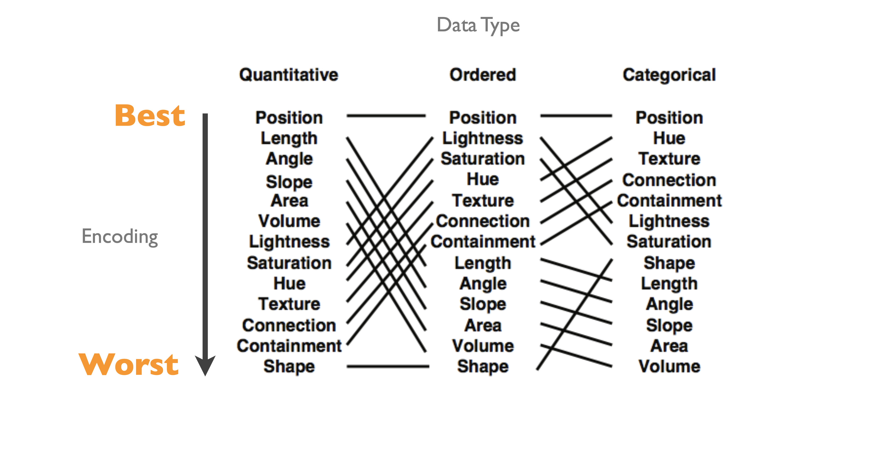
This table about perceptiveness of visual encodings is your friend

Slide 5
Describing and comparing data visualizations
A
B
abundance
abundance
Abundance as quantitative data type
Cell-types as categorical
Healthy vs Disease as categorical
My goal is to make more salient that healthy samples have consistently lower cell-type abundance compared to diseased samples. Which data visualization do you prefer and why?
-> we prefer B

Slide 6
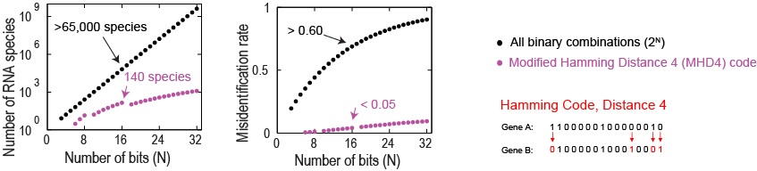
All binary barcodes vs MHD4 code
Using all possible binary barcodes, I can in theory decode 2^N genes across N rounds of imaging
Using a MHD4 code, how many less genes can I decode across N rounds of imaging?
https://www.science.org/doi/10.1126/science.aaa6090

Slide 7
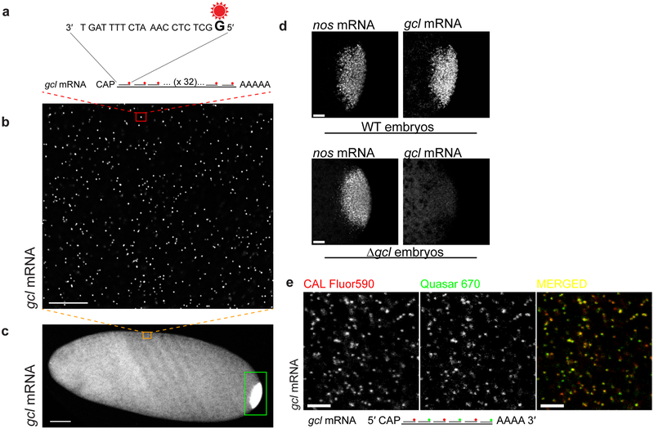
Potential limitations of smFISH/MERFISH
If I need 20 nucleotides for each probe, and 16 probes with a fluorophore each to have a sufficiently bright spot, what is the shortest gene (in terms of number of nucleotides) I can image with smFISH (based on this design)?
20*16 -> probes do not overlap
How long is a microRNA?
22 bp
Can I image microRNAs?
https://www.ncbi.nlm.nih.gov/pmc/articles/PMC6668020/

Slide 8
Potential limitations of smFISH/MERFISH
Why are some spots bigger (and brighter) than others?
More probes than others
Targeting regions are different thermodynamics (high GC rich regions)
Modifications and other things that prohibit binding of probes
Offtarget binding -> some faint spots are false positives
Big spots could be 2 RNAs right next to each other
“Optical crowding”
Some spots are out of focus
https://www.ncbi.nlm.nih.gov/pmc/articles/PMC6668020/

Slide 9
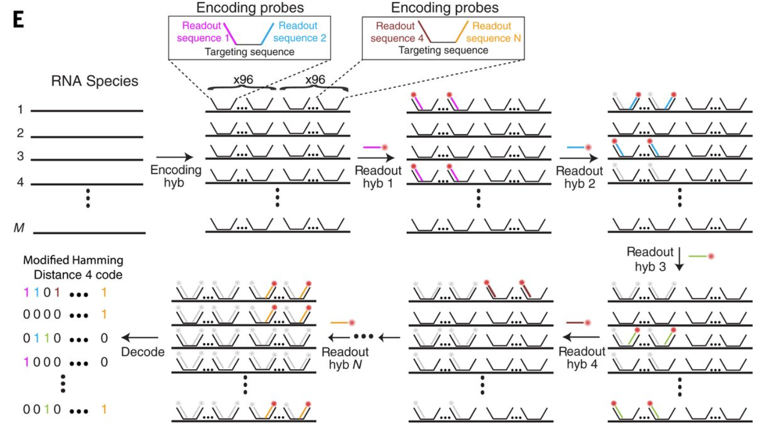
Potential limitations of smFISH/MERFISH
I am designing a gene “codebook” for my MERFISH experiment to be done across 5 rounds of imaging
My codebook is such that each gene has at most two “on bits” (two 1s)
11000
01100
10010
etc
What is the shortest gene (in terms of number of nucleotides) I can decode?
https://www.science.org/doi/10.1126/science.aaa6090

Slide 10
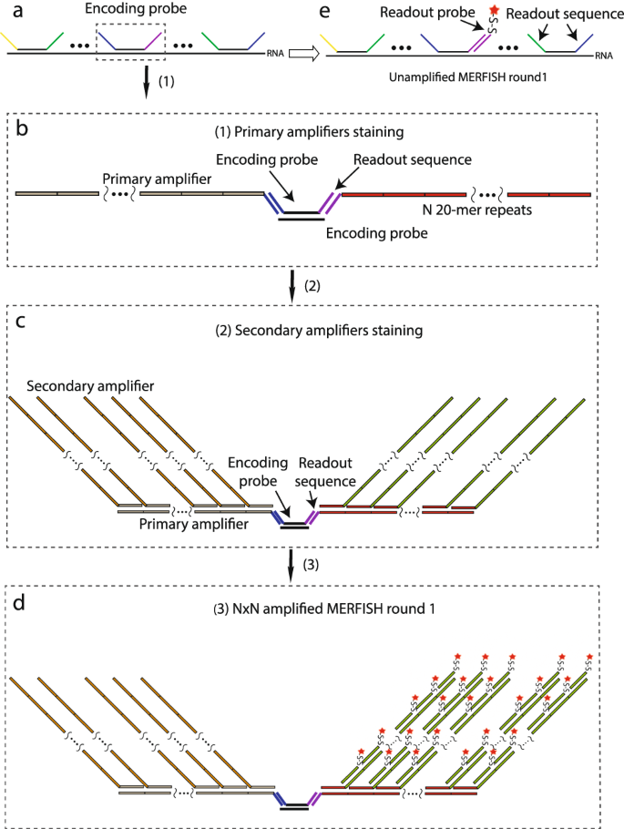
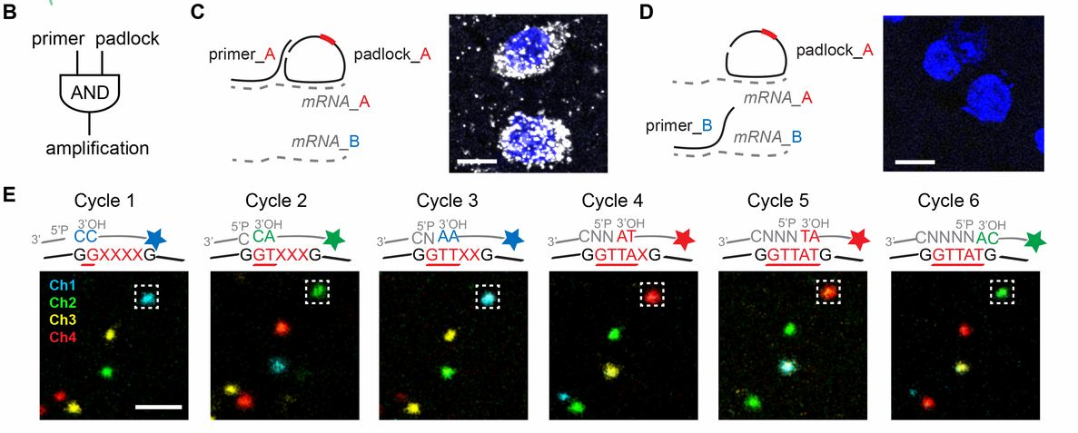
Alternative strategies
https://www.nature.com/articles/s41598-019-43943-8

Slide 11
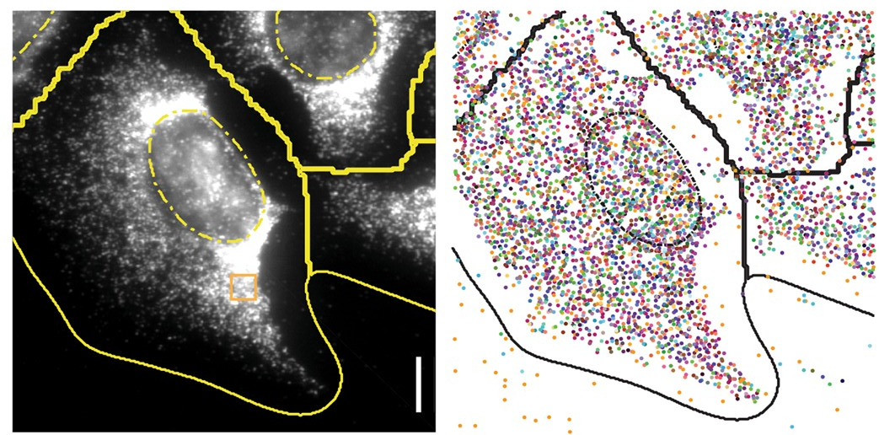
Raw versus decoded data
1 imaging round
Decoded data

Slide 12
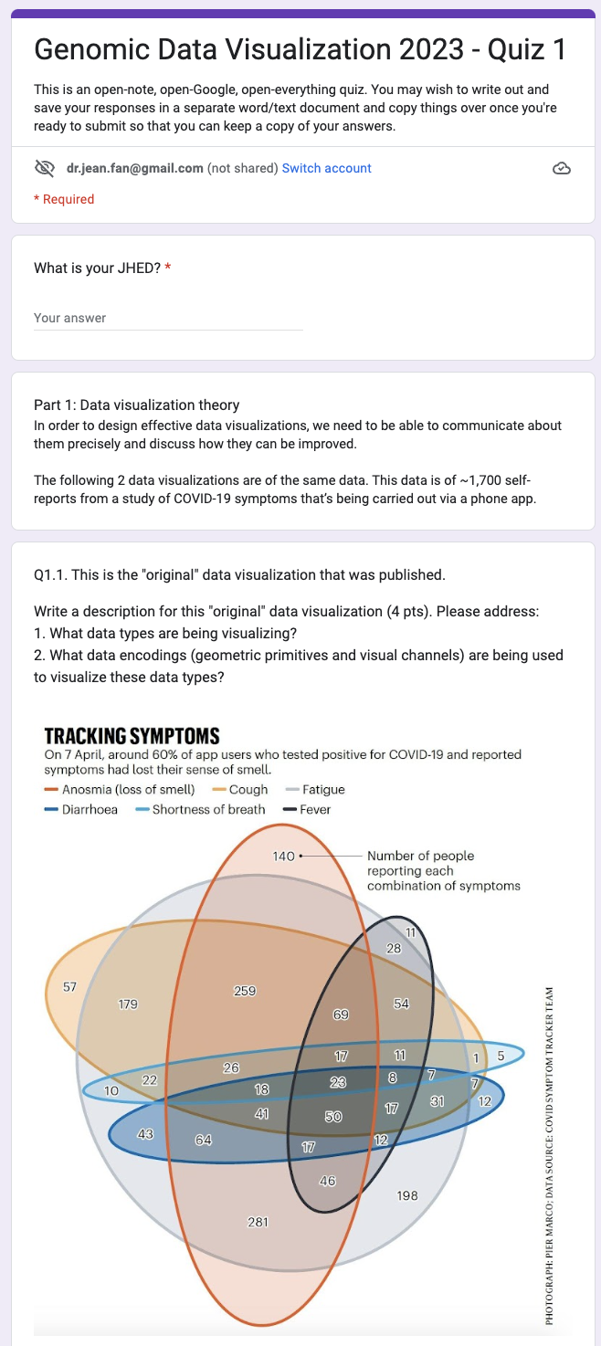
Quiz: bit.ly/GDV23_quiz1 when you’re done: bit.ly/GDV23_rc

